Slide 1



Microstructural Characterization of Nickel Superalloys
Travis Skinner
Mentor: Dr. Aditi Chattopadhyay
Siddhant Datta
School for Engineering of Matter, Transport, and Energy
Arizona State University
Notes:
Acknowledge Dr. Chattopadhyay, Siddhant. Many thanks to the folks at AIMS Center.

Slide 2
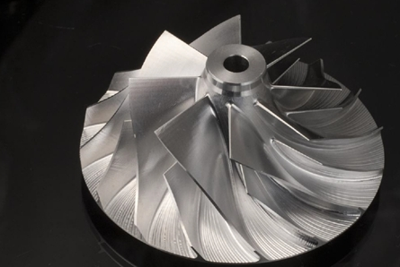
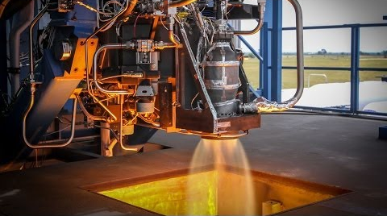
Superalloy Background
Inconel 718 (IN 718)
Among the most widely used superalloys
Resistant to high temperature and fatigue
Rene N5
Single crystalline material
Excellent creep and fatigue resistance
Lightweight IN turbine wheel.
http://masterpower.eu/turbo-specifications-explained
Rocket engine with Inconel nozzle
http://www.spacex.com/news/2014/07/31
Notes:
Among the most widely used superalloys in gas turbine and rocket engine applications.
Extremely high temperatures tend to cause creep in polycrystalline materials due to the sliding and shifting of grain boundaries. Alloys such as Rene N5 mitigate this problem because they do not have grain boundaries.
Rene (single crystal) is made using directional solidification casting.
These alloys can withstand extreme environments, can be used in many space applications.
I am doing this research in order to understand how the microstructure affects material failure.

Slide 3
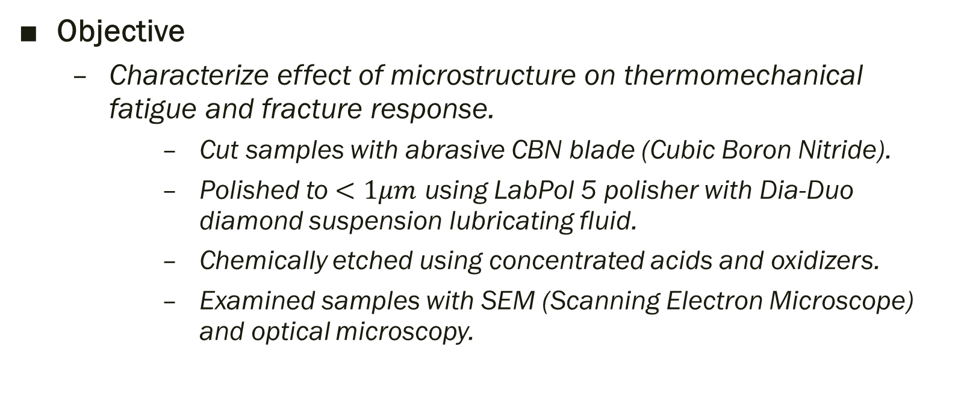
Research Methodology
Objective
Characterize effect of microstructure on thermomechanical fatigue and fracture response.
Cut samples with abrasive CBN blade (Cubic Boron Nitride).
Polished to $<1μm$ using LabPol 5 polisher with Dia-Duo diamond suspension lubricating fluid.
Chemically etched using concentrated acids and oxidizers.
Examined samples with SEM (Scanning Electron Microscope) and optical microscopy.

Slide 4
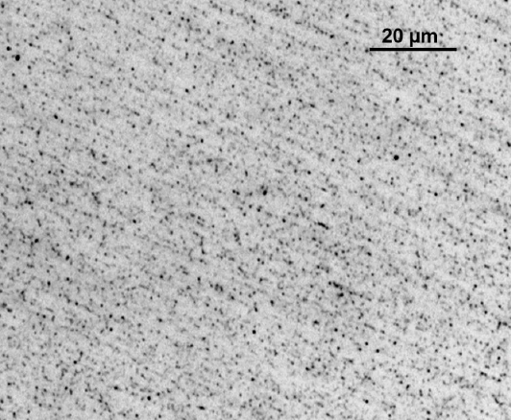

IN 718-Healthy
Confocal microscope image of healthy IN 718 after etching with Glycerygia, which dissolves the γ’ phase.
Healthy IN 718 etched with $H_{2}O_{2}$ and $HCl$. This attacks high-energy grain boundaries.
Notes:
The image on the right is an etch showing the general grain structure of IN 718. The average grain size was about 16 $μm$.
The etch used in this case attacked the high-energy grain boundaries.
A precipitate is a hard particle which forms within the metal matrix. The precipitates block crack growth, improve material strength.
$γ′$ is a cubic precipitate composed of nickel, aluminum, titanium, and niobium.
Matrix phase, $γ$ is primarily composed of nickel, iron, and chromium.
Glycerygia was made with nitric acid, hydrochloric acid, and glycerin. It specifically targeted the $γ′$ phase.
Note the approximate size of the specks (gamma prime precipitates) in this image. These particles are approximately 1-2 $μm$.

Slide 5
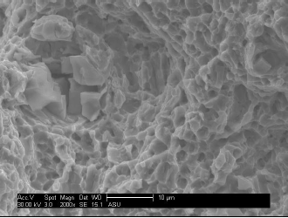
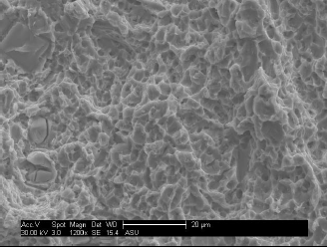
IN 718-Fatigued to Fracture
SEM images of fractured IN 718. Note the dimpled nature of fracture surface.
Notes:
SEM images of fractured IN 718. Note the highly dimpled nature of the fracture surface. As the fatigue crack nears fracture, the more malleable matrix deforms around the stiffer γ’ precipitates. The matrix necks (stretches) and then ruptures, leaving the pockmarked regions shown in these images.

Slide 6
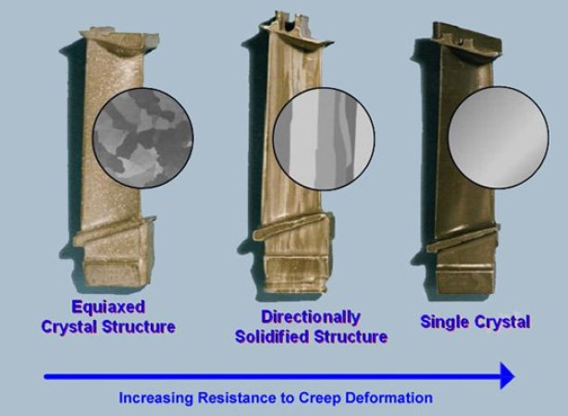

Rene N5-Healthy
Crystal structure and creep resistance
http://makezine.com/2012/01/16/single-crystal-superalloys/
SEM image of $γ′$ precipitates in Rene N5.
Notes:
The lighter matrix phase stands in relief to the recessed areas where the γ’ was. The very selective Glycerygia etchant was extremely effective at dissolving only the γ‘ phase.
This image clearly shows the cubic nature of the $γ′$ particles.

Slide 7
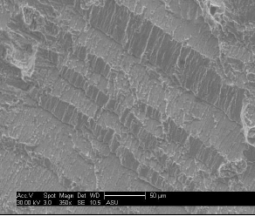
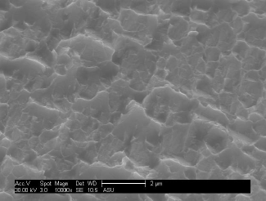
Rene N5-Fatigued to Fracture
SEM image of fractured N5. Note “step” pattern on fracture surface.
Dimples similar to those seen in IN 718 samples.
Notes:
SEM image of fractured N5. These steps likely occur as the fatigue crack encounters a deformation twin boundary. The crack is deflected along the twin boundary before continuing to grow.

Slide 8
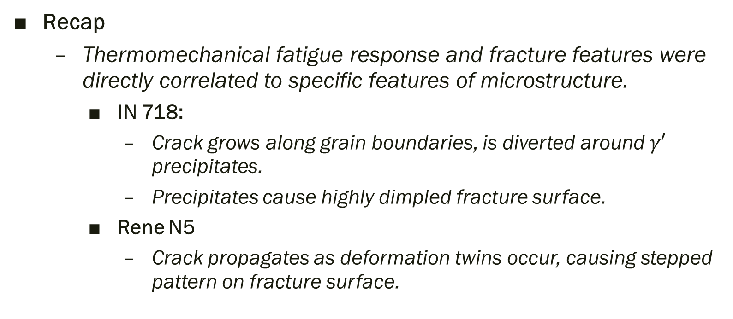
Concluding Remarks
Recap
Thermomechanical fatigue response and fracture features were directly correlated to specific features of microstructure.
IN 718:
Crack grows along grain boundaries, is diverted around $γ′$ precipitates.
Precipitates cause highly dimpled fracture surface.
Rene N5
Crack propagates as deformation twins occur, causing stepped pattern on fracture surface.
Notes:
As we understand how these materials fail, we can improve their performance.

Slide 9
Future Work
Further fractographic analysis
Study micromechanisms governing fatigue crack growth.
Analyze different crack growth stages and correlate fracture features to microstructure.
Fatigue crack initiation
Analyze how repeated loading affects microstructure.
Study slip bands within fatigued material

Slide 10
Thank you!
Questions?

